Slide 2
Welcome & Ground Rules
Sessions Run from 8:30am – 2:05pm
Break for lunch - 12:05pm – 12:30pm
We will be prompt
Please remain on MUTE unless you have questions
We will be recording

Slide 3
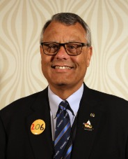
State of the DISTRICT
Dennis Baugh
2020 – 2021 Capital District Governor

Slide 4
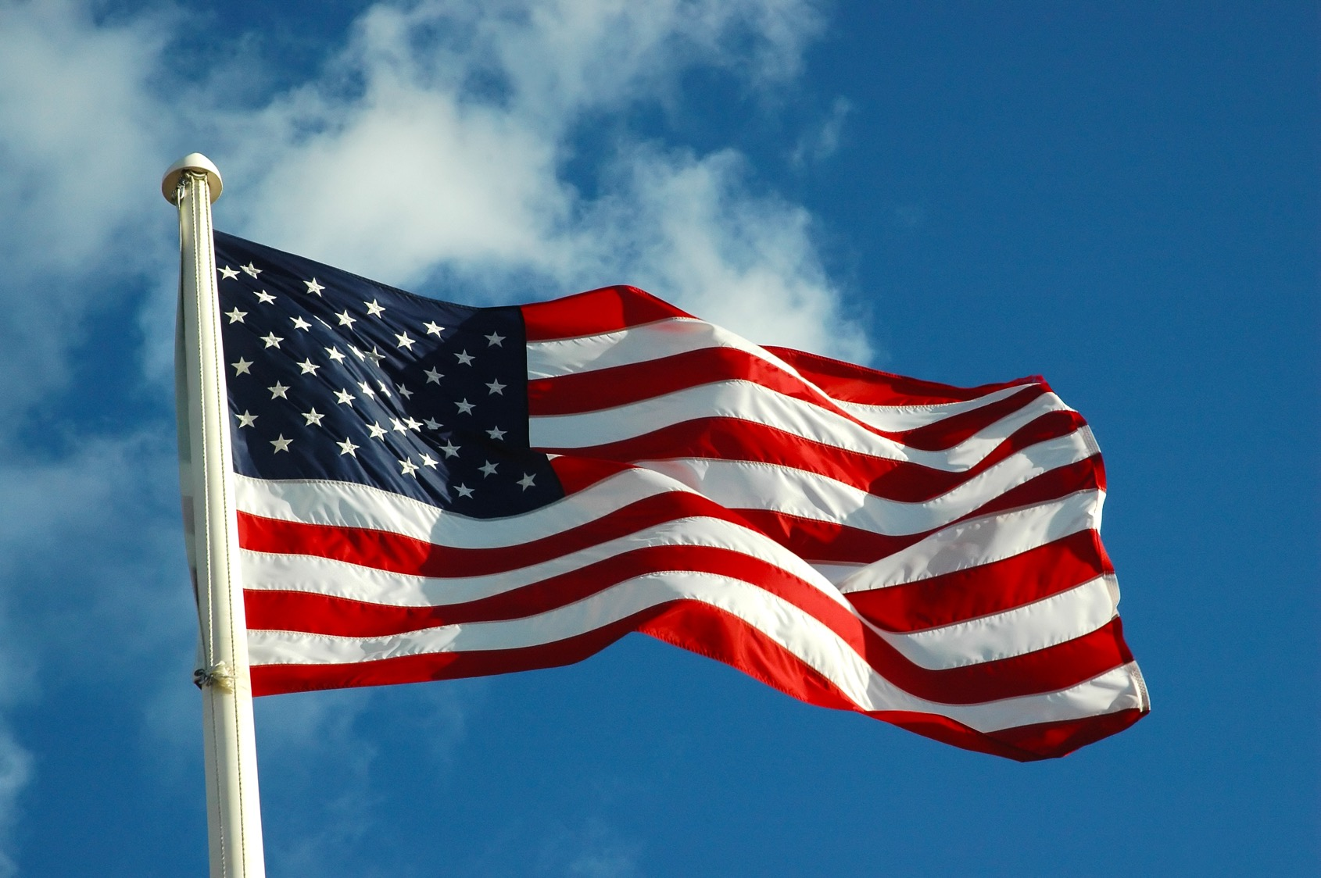

Slide 5
Agenda
20 – 30 Minute Sessions Based upon the Kiwanis Mission Statement
2 Keynote Speakers
6 Presenters
Spiritual & Human Values Presentation
Commercials

Slide 6
Our Mission Kiwanis is a global organization of volunteers dedicated to improving the world one child and one community at a time.

Slide 7
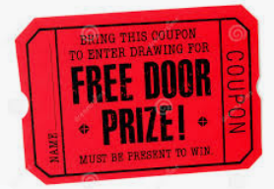
Door Prizes
Drawings will happen after every Speaker
All Prizes donated by our Amazing LTGs and Clubs (Thank You!!)
If you registered, you are eligible & we have your information
Prizes emailed or mailed
You may celebrate ☺

Slide 8
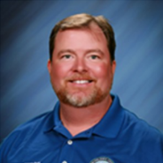
Opening Keynote Speaker
Dr. Peter Gretz
Superintendent of Middlesex County Public Schools

Slide 9
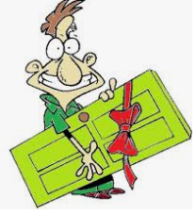
Door Prizes

Slide 10
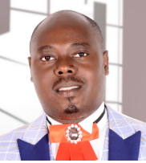
Kiwanis is a Global Organization
Presenter: Albertcook Isingoma
Charter President – Kiwanis Club of Nakawa, Uganda

Slide 11
Door Prizes

Slide 12
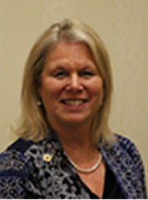
Of Volunteers
Moderator: Caren Schumacher
Capital District Membership/ Growth Chair
Panel:
Mike Rock
Jack Hassman
Michelle Yuth

Slide 13
Kiwanis – A Global Organization of Volunteers
Moderator
Caren Schumacher, Capital District
Membership Coordinator
Panel
Mike Rock, Kiwanis Club of Williamsburg
Jack Hassman, Kiwanis Club of Bridgeville
Michelle Yuth, Kiwanis Next Generation e-Club
Notes:
Want to overcome the effects the Coronavirus has had on your club and finish the year strong?! This session will provide ideas that will help participants develop a wellness plan for a healthier club. Focusing on retention, recruitment and branding, you’ll hear ideas to re-engage current members, grow membership and increase visibility for the Kiwanis name in your community.
caren

Slide 14
Mike Rock – Kiwanis Club of Williamsburg
Notes:
There is no take these two pills and call me in the morning fix. We are doing Kiwanis business differently and while it might be "a hard pill to swallow" for some, we have to adapt to the new normal.
We hope you find this workshop practical and also humerous
emily

Slide 15
Jack Hassman – Kiwanis Club of Bridgeville

Slide 16
Michelle Yuth - Kiwanis Next Generation e-Club

Slide 17
Questions?
Caren Schumacher
Capitol District Membership Coordinator
carenkiwanis@aol.com
(757) 876-8239
Notes:
Don’t reach out to the wrong person for a diagnosis or remedy for what ails your club. The two of us are on call to take your call! Thanks for joining us today
caren

Slide 18
Door Prizes

Slide 19
Commercial
Signature Project Winner #1
Roanoke Club – Centennial Park

Slide 20
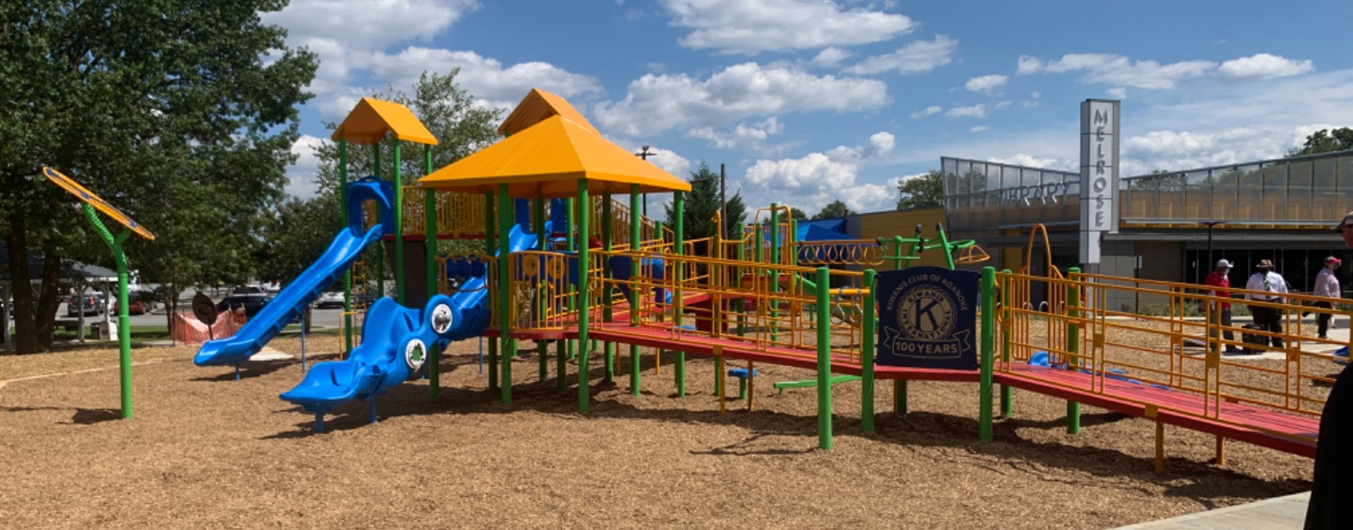
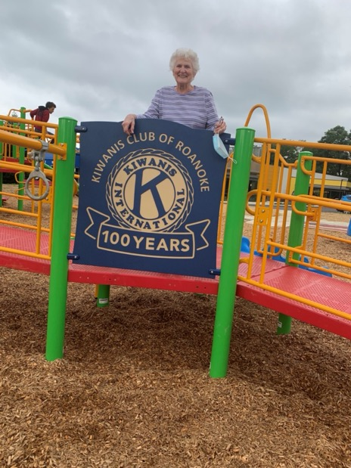
Kiwanis Centennial Playground
August 30, 2020
Kiwanis club of Roanoke centennial signature project

Slide 21
Four years of planning, fundraising, spreading the word and gathering support led to…
The 10,000 square foot inclusive playground in high need neighborhood in Roanoke, VA built in celebration of and culminating 100 years of service of the Kiwanis Club of Roanoke!
$420,000 raised – playground completed and gifted to the City of Roanoke so all can actively play together strengthening their health, social, cognitive and community well being!

Slide 22
Support was community-wide and extended beyond Roanoke! Thank you!
Churches and synagogues all over the Roanoke Valley
Private sector: Businesses and organizations large and small
Kiwanis Club of Roanoke members and non-Kiwanians with sacrificial gifts
Public sector support from the City of Roanoke, public library, Housing Authority, Roanoke City Public Schools, City Parks and Recreation
Individuals living right in the neighborhood with coin jars placed in local businesses and passing the plate during a Sunday worship service
Fundraisers like the Kiwanis Pancake and Auction Day, Bocce Ball tournaments, a spaghetti dinner, and evening events to cultivate donor support
Grantwriting and grant awards
Capital District and Kiwanis Children’s Fund support
All made the dream come true for our children most in need!

Slide 23
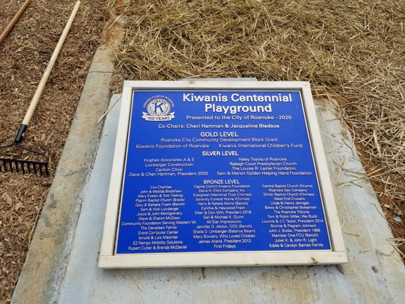
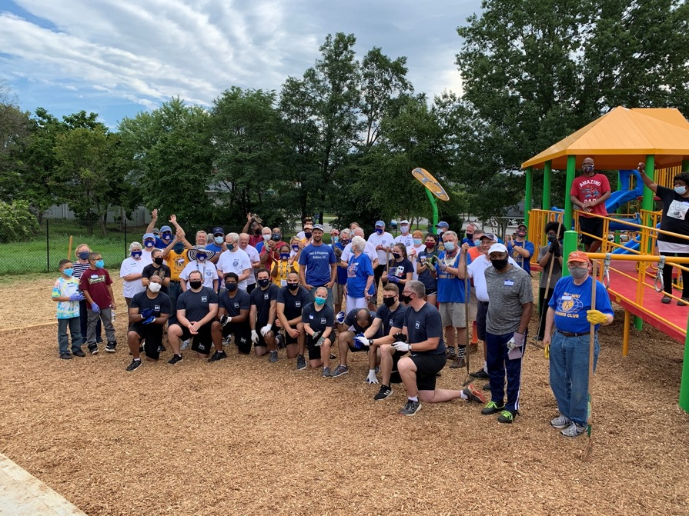
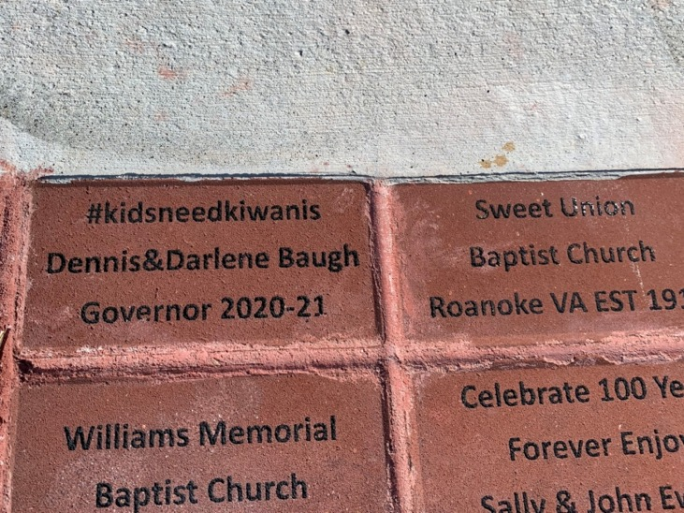
From dream to reality because a community came together! Police recruits on mulching day; plaque and bricks honor donors

Slide 24
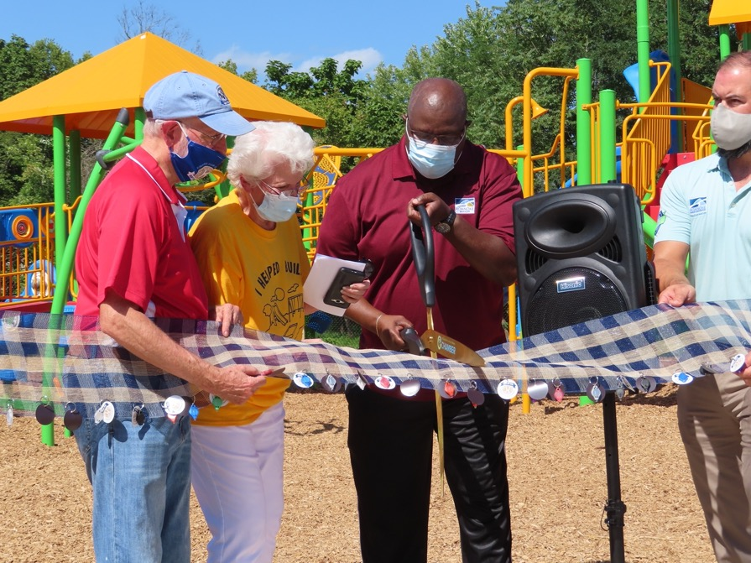
Mulching day transitioned to ribbon cutting and giving the gift of play!

Slide 25
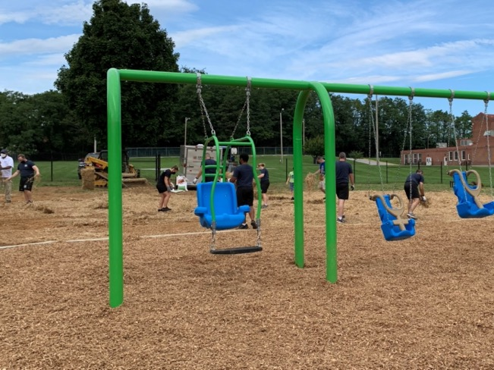
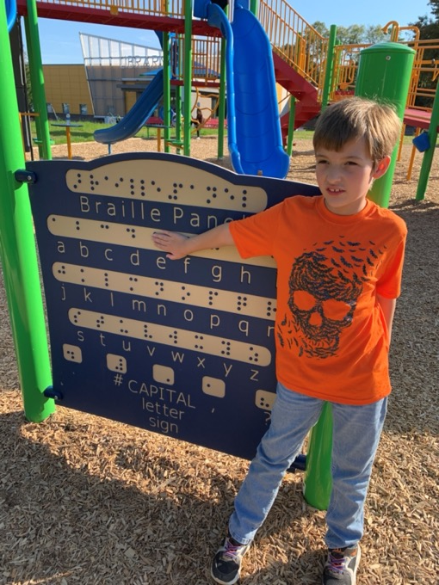
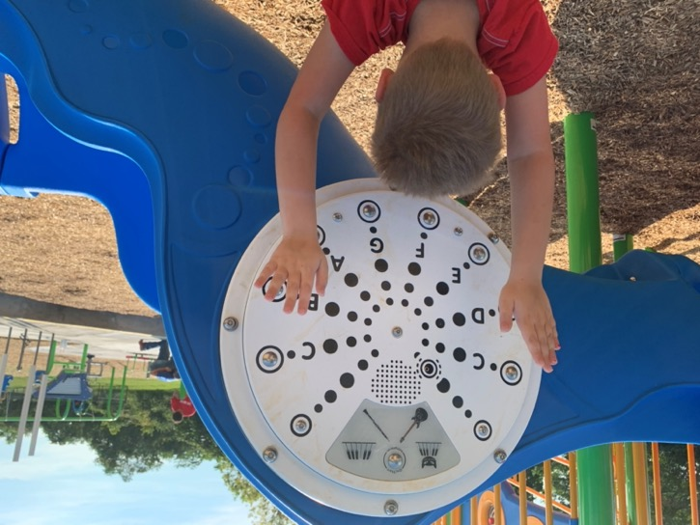
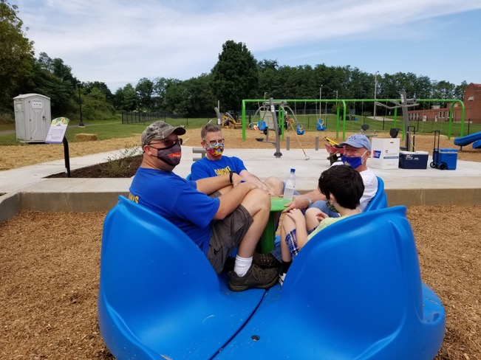
Inclusivity so all may play! Braille panel Harnessed swing, Merry Go All, Sensory panel

Slide 26
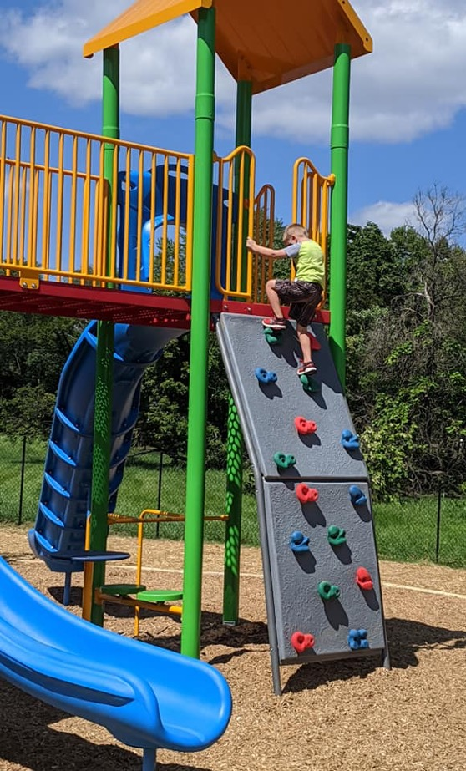
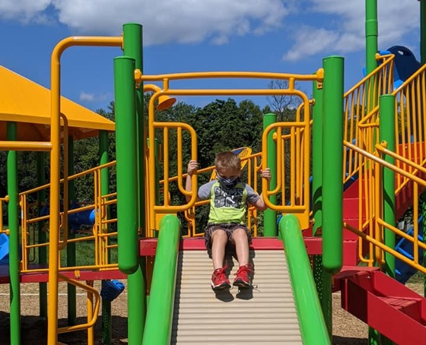
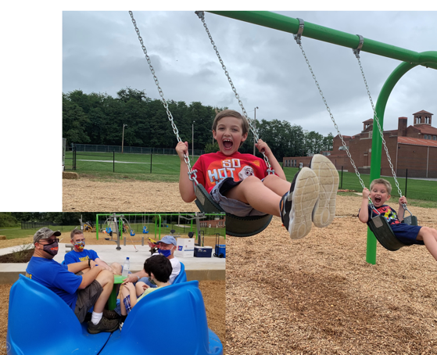
The Fun Begins! Families Gather, Kids Play, Kiwanians Help Children in Need
We are starting a new century of service as we build on this foundation of commUNITY and continue to partner with every sector of the Roanoke Valley to foster healthy and successful youth development AND neighborhood strengthening so that all may pursue and achieve their dreams!

Slide 27
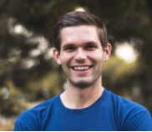
Dedicated to Improving the World
Presenter: Chris Frye
Charter Member Kiwanis Next Gen E-Club

Slide 28
Door Prizes

Slide 29
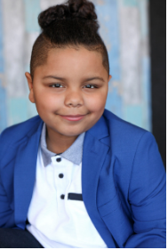
One Child
Presenter: Cavanaugh Bell
Chief Positivity Creator:
Cool & Dope

Slide 30
Door Prizes

Slide 31
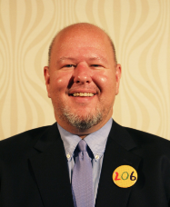
And One Community
Presenter: Eric Lamb
Division 9 LTG
Chair of the Capital K Family Taskforce on Diversity, Equity, and Inclusion

Slide 32
AND ONE COMMUNITY
Update on the DEI Team

Slide 33
We are ONE KIWANIS COMMUNITY

Slide 34
What is D, E and I?
Diversity is where everyone is invited to the party
Equity mean that everyone gets to contribute to the playlist
Inclusion means that everyone has the opportunity to dance.

Slide 35
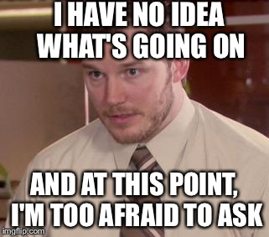
What is happening?
The Team is made up from representatives from KEY Club, Circle K International and Kiwanis
Lots of tri chair meetings
Documents are being gathered
Education modules are in beginning stages
DEI conversations can be hard but they
help us all learn.

Slide 36
How are our Clubs Functioning?

Slide 37
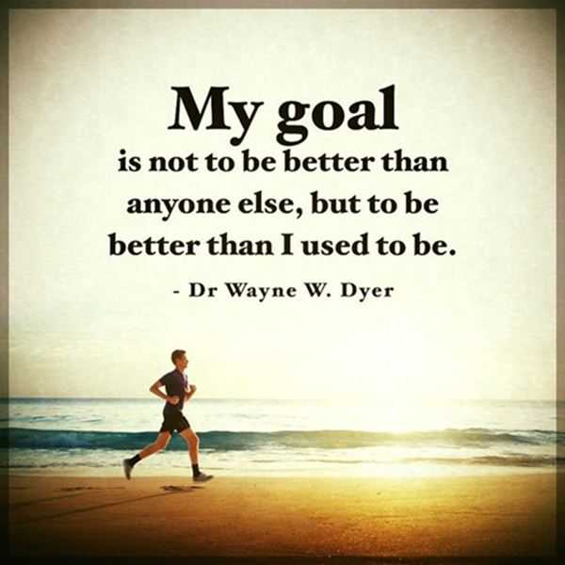
Our Goal:

Slide 39
Door Prizes

Slide 40
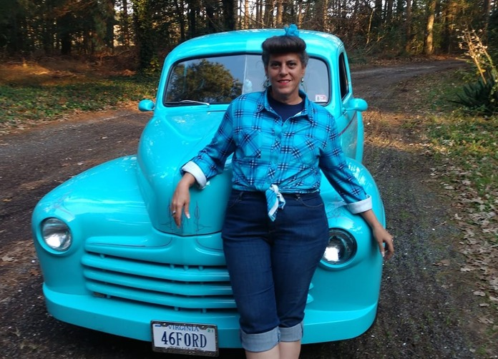
At A Time
Presenter: Christine Johnson
Division 5 LTG &
Karwanis Founder

Slide 41
Kar-Wanis
What a Classic Idea!

Slide 42
What is A Car Show? Essentially – Beauty Pageant for Cars
Car Show Fund Raiser
Cruise In Fun Raiser
Participants are judged for multiple prizes
Various possible streams of revenue
Sponsors
Concessions
Participants show cars – no judging
Less Man Power Intensive
Promotional Based Venue
Custom Car Events
Identifying new venues to further Spread the Word and open new fund raising opportunities

Slide 43
Start Your Engines!
Our Inaugural Car Show - Pocomoke City, Maryland
Planned in Six Weeks
Venue was Filled to Capacity
Introduced Kiwanis to Community as a Family of Clubs Working Together
Had 90% Division Club Participation at Event
Event was attended by District Governor Dennis Baugh, Immediate Past District Governor, David Lurie, Lt Governor, Christine Johnson Immediate Past Lt Governor, Robin Marks Foundation Director, Charles Marks Past Trustee, Jack Hassman

Slide 44
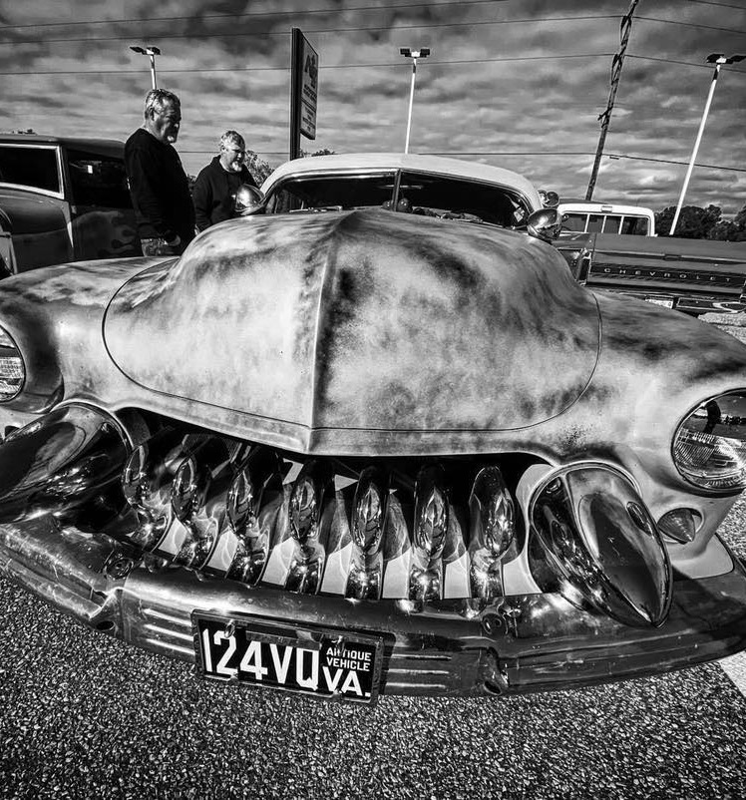
Creation of Kar-Wanis
Kar-Wanis is an event-specific, division wide satellite committee dedicated to planning and executing Kiwanis sponsored car events.

Slide 45
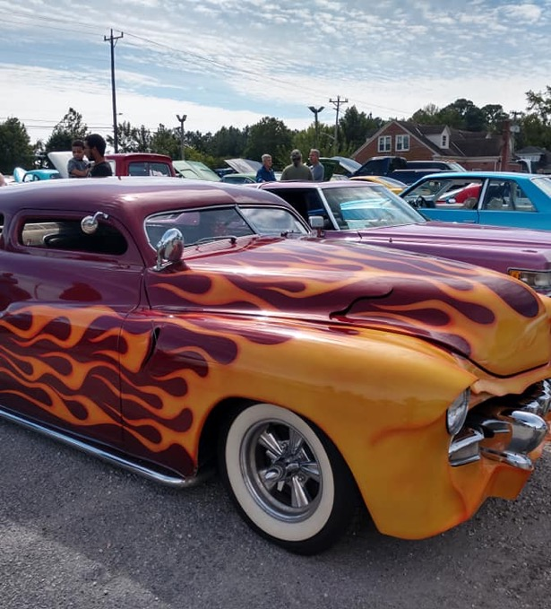
Why Kar-wanis Works
Provides a pool of event knowledgeable volunteers
Kar-wanis has volunteers experienced in promoting and running car events, including promotion, registration and judging
Creates event opportunities for all club sizes
Offers profitable addition to an existing event.
Provides venues for participating clubs for fund-raising opportunities
Multiple clubs with concessions for fund-raising
Provides venues for participating clubs to promote other events or programs
Helps re-energize existing clubs with purpose and opportunity
Creates unique recruitment method for new members
Increases community exposure and partnerships
Promotes stronger Kiwanis family relations including SLPs

Slide 46
Christine Johnson 732-580-4074
Want to know how to get your club or division started?
Questions?
Call or Text

Slide 47
Door Prizes

Slide 48
LUNCH
Please return Promptly at 12:30pm
Next up: Spiritual & Human Values Fellowship

Slide 49
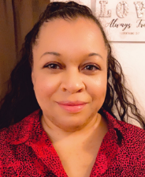
Spiritual and Human Values Fellowship
Elana Gardner, Governor-Elect
Honoring and Remembering our Kiwanis Family That Has Left Before Us

Slide 50
In Remembrance
To provide through Kiwanis clubs, a practical means to form enduring friendships ………

Slide 51
It starts with “One Hello”
Today we pause to turn inward and upward as we give primacy to the human and spiritual rather than the material values of life. We celebrate the lives of our Capital District Kiwanis Family and are comforted knowing that though no longer in our presence they remain with us in our hearts everytime we serve. They inspire us to continue their work and to cherish each moment spent in engagement of our mission together.

Slide 52
Leeann Calvert
Larry Jonas
Robert Hall
E. Bruce Harrison
George Moore
Tommy Pruett
Sharon Thornton

Slide 53
Robert Wheeler
Sydney Andrews
Louise Black
Carol Holland
Roy Lambertson
Nelson Vaughn
John Hager

Slide 54
Robert Mayfield
William Collins
Gary Whitehead
Thomas Barrett
Bert Ferren
Liz Jackson
Albert Super

Slide 55
Earl Zook
David Hooker
Jack Maxwell
Viola Moore
William Steele
Larry Boitnott
Dennis Hartman

Slide 56
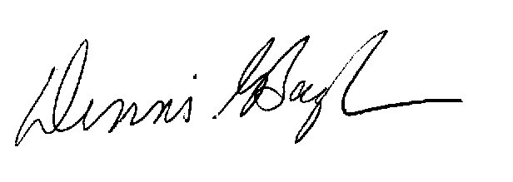
~LEGION OF HONOR ~
Be it known that the following were Kiwanians for a period of Twenty-five or more years as shown by the official organization records. And be it further known that each member was accorded distinctive recognition and will eternally have the admiration and gratitude of their home clubs, Capital District and Kiwanis International.

Slide 57
LEGION OF HONOR 25+ Yrs
LEGION OF HONOR 30+ Yrs
Roscoe Edwards
Frederick Hodnett
William Pinchback
Kathleen Thompson
Charles Williams
Phillip Hottle
Frederick Smith
Dean St. Clair
Thelma Hardy
Frank Lion
Daniel Stoner
Erman Clay
Malcolm Cofer

Slide 58
LEGION OF HONOR 35+ Yrs
LEGION OF HONOR 40+ Yrs
John Burchette
Harry Richardson
Dennis Robin
Thomas Swartz
Douglas Haller
Bruce Santilli

Slide 59
LEGION OF HONOR 45+ Yrs
LEGION OF HONOR 50+ Yrs
John Bowman
Darwin King
William Vanderwende
William Lukens
Paul Collins
Erice Gatrell
John Shumate
Bruce Grover
William Breichner
Samuel Derieux

Slide 60
LEGION OF HONOR 55+ Yrs
LEGION OF HONOR 60+ Yrs
LEGION OF HONOR 65+ Yrs
William Trout
George Harvey
Fletcher Watson
Lee Palmer
Herb Alcorn

Slide 61
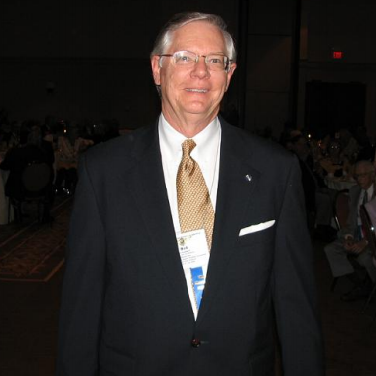
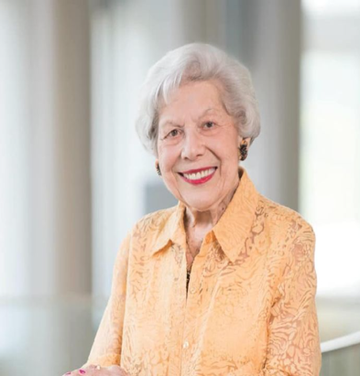
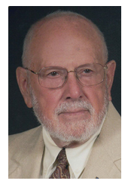
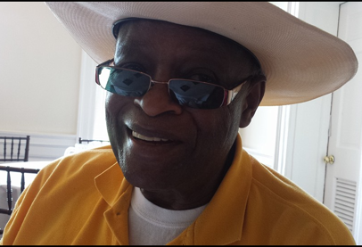
Capital District Leadership- Past Lt. Governors
Frank Dulong
Robert “Bob” Engelbach
Bernice Grossman
JR Harris

Slide 62
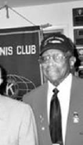
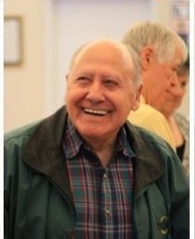
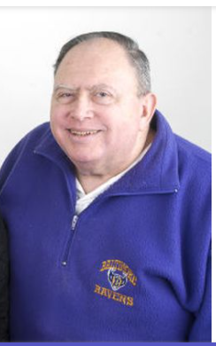
Capital District Leadership- District Chairs
International Understanding
Raga Elim
Human & Spiritual Values
Booker McManus
Risk Manager
Mike Rind

Slide 63
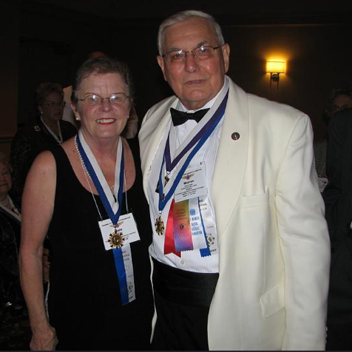
First Ladies of Capital District
Carol Brewer 1972- 1973
Dale Kane 2004- 2005

Slide 64
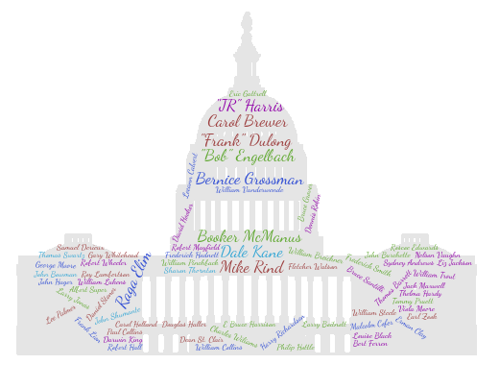
Capital District …...together we make a family
Kathleen Thompson
Notes:
100%, Close, God Bless the Child, Prayer (The), 9-5, How Does a Moment Last Forever, Rainbow Connection, Amazing Grace
I Still believe, River, Believe in Yourself, Lean on Me, Somewhere out There, Bridge Over Troubled Water, Living Proof
Stand by Me, Caravan of Love, Love's in Need of Love
This is where I sleep
Don't Worry Be Happy
Loyal, Brave & True
Tomorrow
Everybody Hurts
Man in the Mirror
Unforgettable
Fiddler
Mercy Said No
We are the World
From a Distance
One Moment in Time
What Friends Are For
Give Love on Christmas Day
Overcomer
Won't You be my neighbor

Slide 65
State of the DISTRICT
Dennis Baugh
2020 – 2021 Capital District Governor

Slide 66
Governor-Elect candidate REMARKS

Slide 67
Door Prizes

Slide 68
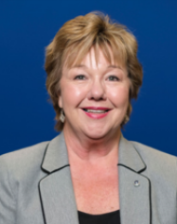
Closing Keynote Speaker
Katrina Jones Baranko
Kiwanis International Trustee
Board Counselor to the Capital District
A Look Into the
Future

Slide 69
WRAP UP
A BIG THANK YOU Presenters, Attendees, the Conference Committee & Clubs/Divisions that donated door prizes
All presentations have been recorded and will be placed on our Capital District Site
FINAL Door Prizes

Slide 70
Grand Finale of Door Prizes

